Slide 1
Welcome to English Class 5/5
Let's go 2A
Teacher : Ngo Thi Thanh Hang

Slide 2
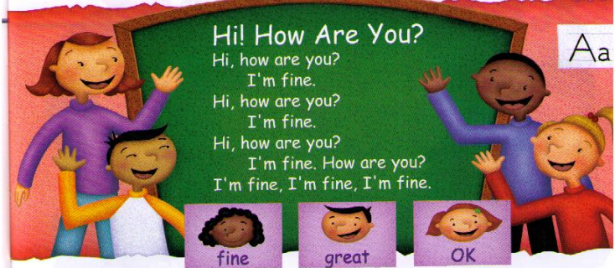
Wednesday, October 31st ,2018.

Slide 3
Wednesday, October 31st ,2018.
Unit 2: MY THINGS
* Review the previous lesson :
Unscramble the sentences:
a/ I/ comic/ have/ book.
………………………………
2. have /I /bar/ candy/a.
………………………………3. brush / I/ have/ a.
………………………………
4. I / a/ have/ tissue.
………………………………
I have a comic book.
I have a candy bar.
I have a brush.
I have a tissue.

Slide 4
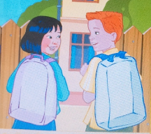
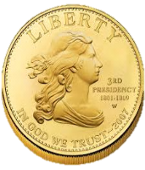
Wednesday, October 31st ,2018.
Unit 2: MY THINGS
Let’s learn (Continue)
C. Practice the question and answer.
* Introduce the new structures:
A: What do you have?
B: I have a coin.

Slide 5
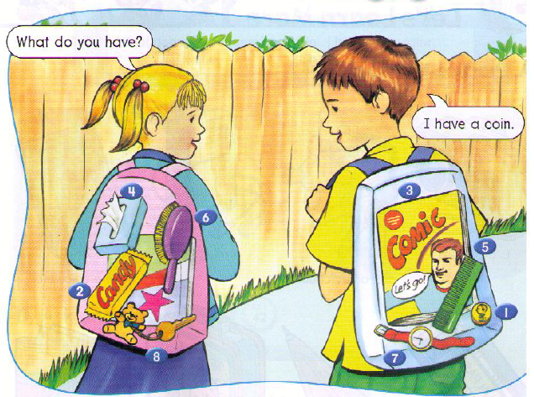
Wednesday, October 31st ,2018.
Unit 2: MY THINGS
Let’s learn (Continue)
C. Practice the question and answer.
* Practice:(3ms)

Slide 6
Wednesday, October 31st ,2018.
Unit 2: MY THINGS
Let’s learn (Continue)
C. Practice the question and answer.
* Practice:
1.
What do you have?
I have a coin.

Slide 7
Wednesday, October 31st ,2018.
Unit 2: MY THINGS
Let’s learn (Continue)
C. Practice the question and answer.
* Practice:
2.
What do you have?
I have a candy bar.

Slide 8
Wednesday, October 31st ,2018.
Unit 2: MY THINGS
Let’s learn (Continue)
C. Practice the question and answer.
* Practice:
3.
What do you have?
I have a comic book.

Slide 9
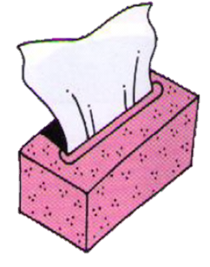
Wednesday, October 31st ,2018.
Unit 2: MY THINGS
Let’s learn (Continue)
C. Practice the question and answer.
* Practice:
4.
What do you have?
I have a tissue.

Slide 10
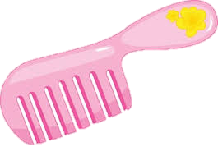
Wednesday, October 31st ,2018.
Unit 2: MY THINGS
Let’s learn (Continue)
C. Practice the question and answer.
* Practice:
5.
What do you have?
I have a comb.

Slide 11
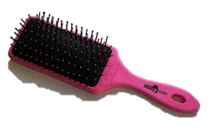
Wednesday, October 31st ,2018.
Unit 2: MY THINGS
Let’s learn (Continue)
C. Practice the question and answer.
* Practice:
6.
What do you have?
I have a brush.

Slide 12
Wednesday, October 31st ,2018.
Unit 2: MY THINGS
Let’s learn (Continue)
C. Practice the question and answer.
* Practice:
7.
What do you have?
I have a watch.

Slide 13
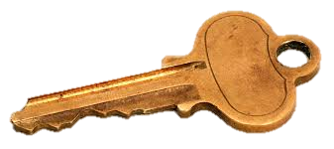
Wednesday, October 31st ,2018.
Unit 2: MY THINGS
Let’s learn (Continue)
C. Practice the question and answer.
* Practice:
8.
What do you have?
I have a key.

Slide 14
Wednesday, October 31st ,2018.
Unit 2: MY THINGS
Let’s learn (Continue)
C. Practice the question and answer.
* Free practice: (2 ms)
What do you have?
I have ………..

Slide 15
Wednesday, October 31st ,2018.
Unit 2: MY THINGS
Let’s learn (Continue)
C. Practice the question and answer.
Passing balls game

Slide 16
Wednesday, October 31st ,2018.
Unit 2: MY THINGS
Let’s learn (Continue)
C. Practice the question and answer.
A: What do you have?
B: I have a coin.

Slide 17
Wednesday, October 31st ,2018.
Unit 2: MY THINGS
Let’s learn (Continue)
HOMEWORK
-Learn the lesson by heart.
-Prepare for next part.

Slide 18
Thank you very much.

